Slide 1

Computer Communication Networks
(18ECC303J)
Dr B. Ramachandran
Professor/ECE
SRMIST

Slide 2
Syllabus Coverage
Basics of Data Communication and Networking
  Transfer modes, network categories, topologies, layered architecture, protocols and standards, switching types, and LAN standards
Data Link Layer
  Error detection and correction, flow control, HDLC
Network Layer
  Addressing, IP, Routing protocols – RIP, OSPF, BGP
Transport Layer
  UDP, TCP congestion control, QoS techniques
Application Layer
  SIP, Compression, Encryption, E-mail, FTP, HTTP, SNMP

Slide 3
Reference Books
1. Behrouz A.Forouzan, “Data communication & Networking”, Mc-Graw Hill, 5th Edition Reprint, 2014.
2. Andrew S.Tanenbaum, “Computer Networks”, Pearson Education India, 5th Edition, 2013.
3. William Stallings, “Data & Computer Communication”, Pearson Education India, 10th Edition, 2014.
4. James F. Kurose, Keith W. Ross, “Computer Networking: A Top–Down Approach Featuring the Internet”, Pearson Education,6th Edition, 2013.

Slide 4
Internal Assessment
CT1 – 5 marks (Unit-1)
CT2 – 7.5 marks (Units 2 & 3)
CT3 – 7. 5 marks (Units 4 & 5)
Assignments & Surprise Test – 5 marks
Total: 25 Marks
Lab component carries another 25 marks of internals
End sem exam: Theory – 25 Marks, Lab – 25 Marks

Slide 5
Data Communication and Networking: Basics
Data Communication
  Characteristics, Components, Data types, Modes (flow)
Networks
  Criteria, Connection, Topology, Categories

Slide 6
DATA COMMUNICATION
Data communications is the exchange of data between two devices via some form of Transmission medium such as a wire cable.
For data communications to occur, the Communicating devices must be part of a communication system made up of a combination of hardware (physical equipment) and software (programs).

Slide 7
Fundamental Characteristics
Delivery:
The system must deliver data to the correct destination.
Data must be received only by the intended device or user.
Accuracy:
The system must deliver the data accurately (error free)
Data that have been altered in transmission and left uncorrected are unusable.
Timeliness:
The system must deliver data in a time manner. Data delivered late is useless.
In the case of video and audio, timely delivery means delivering data as they are produced, in the same order that they are produced, and without significant delay.
Jitter:
Jitter refers to the variation in the packet arrival time(inter-packet delay variation).
It is the uneven delay in the delivery of audio or video packets that results in uneven quality.

Slide 8
Components
Message:
The message is the information (data) to be communicated.
Popular forms of information include text, numbers, pictures, audio, and video.
Sender:
The sender is the device that sends the data message.
It can be a computer, workstation, telephone handset, video camera, and so on.
Receiver:
The receiver is the device that receives the message.
It can be a computer, workstation, telephone handset, television, and so on.
Transmission medium:
The transmission medium is the physical path by which a message travels from sender to receiver such as twisted-pair wire, coaxial cable, fiber optic cable, and radio waves.
Protocol:
protocol is a set of rules that govern data communications between the communicating devices.
It determines what is communicated, how it is communicated and when it is communicated.
Without a protocol, two devices may be connected but not communicating.
The key elements of a protocol are syntax, semantics, and timing.

Slide 9

Components (contn..)

Slide 10
Elements of Protocol
Syntax
  Structure or format of the data
  Indicates how to read the bits - field delineation
Semantics
  Interprets the meaning of the bits
  Knows which fields define what action
Timing
  When data should be sent and what
  Speed at which data should be sent or speed at which it is being received.
Examples: PPP, IP, TCP, FTP, HTTP, SMTP, SNMP….

Slide 11
Standards
There are two major categories : 1. De facto 2. De jure
De facto standards
It just happened or accepted without any formal plan.
IBM has developed its own standards for a PC
It was accepted internationally as a De facto standard
De jure standards
These standards are planned and developed by authorized standards creating bodies
IEEE, ITU, ISO and IETF Standards are examples for these standards.

Slide 12
Data Representation
Text :
is a sequence of bits.
Different sets of bit patterns have been designed to represent text.
Each set is called a code, and the prevalent coding system is called Unicode, which uses 32 bits to represent a symbol or character used in any language.
Numbers:
are also represented by bit patterns.
Instead of code, the number is directly converted to a binary number to simplify mathematical operations.
Images:
are also represented by bit patterns. An image is composed of a matrix of pixels (picture elements).
Each pixel is assigned a bit pattern.
The size and the value of the pattern depend on whether the image is binary, gray or color.

Slide 13
Data Representation contd…
Audio
refers to the recording or broadcasting of sound or music.
Audio is by nature different from text, numbers, or images.
It is continuous, not discrete.
Video:
refers to the recording or broadcasting of a picture or movie.
Video can either be produced as a continuous entity, or it can be a combination of images in motion.

Slide 14
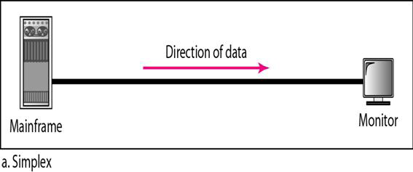
Data Flow Types
Simplex
In simplex mode, the communication is unidirectional.
Only one of the two devices on a link can transmit; the other can only receive.
For example, keyboard can only introduce input; the monitor can only accept output.

Slide 15
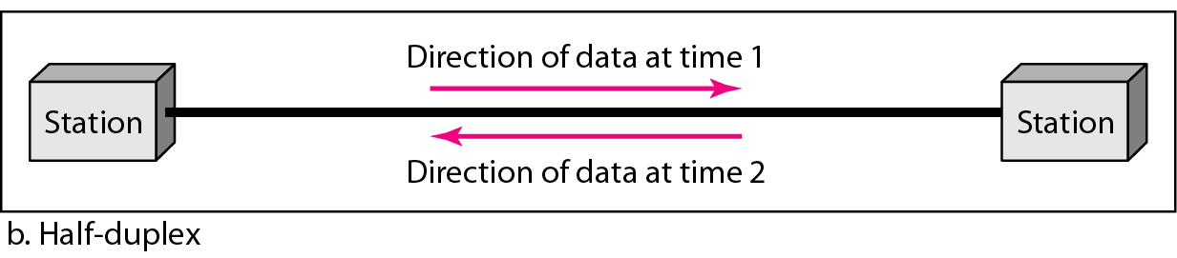
Data Flow Types
Half-Duplex
In half-duplex mode, each station can both transmit and receive, but not at the same time.
When one device is sending, the other can only receive, and vice versa.
Walkie-talkies and CB (citizens band) radios are both half-duplex systems.
Thus the entire capacity of the channel can be utilized for each direction

Slide 16
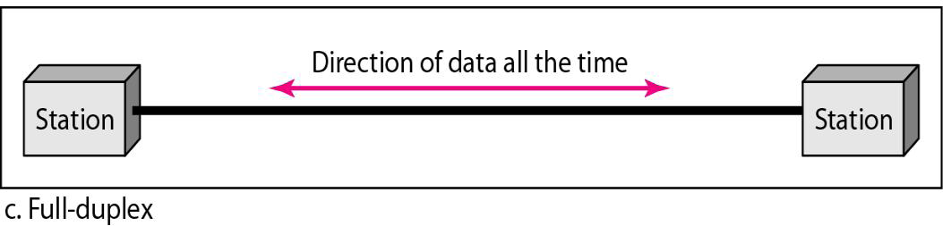
Data Flow Types
Full-Duplex
In full-duplex mode (also called duplex), both stations can transmit and receive simultaneously.
An example is the telephone network.
Therefore, either the link must contain two separate physical transmission paths (sending and receiving) or the capacity of the channel is divided between signals traveling in both directions

Slide 17
NETWORK
A network is a set of devices (often referred to as nodes) connected by communication links.
A node can be a computer, printer, or any other device capable of sending and/or receiving data.
In distributed processing, a task is divided among multiple computers on the network, instead of one single large machine being responsible for all processing.

Slide 18
Network Criteria
Performance :
The performance of a network depends on number of users, transmission medium, hardware, software, etc.
Performance is often evaluated by two metrics: throughput and delay.
It is desirable to have more throughput and less delay.
Reliability:
Network reliability is measured by the frequency of failure, the time it takes a link to recover from a failure, and the network's robustness in a catastrophe.
Security:
Network security issues include protecting data from unauthorized access, protecting data from damage and development, and implementing policies and procedures for recovery from breaches and data losses.

Slide 19
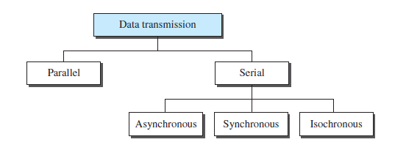
Transmission modes
Do we send 1 bit at a time or group bits into larger groups and, if so, how?
The transmission of binary data across a link can be accomplished in either parallel or serial mode.
In parallel mode, multiple bits are sent with each clock tick.
In serial mode, 1 bit is sent with each clock tick. There are three subclasses of serial transmission: asynchronous, synchronous, and isochronous.

Slide 20
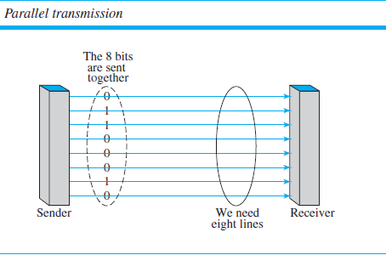
Binary data, consisting of 1s and 0s, may be organized into groups of n bits each.
By grouping, we can send data n bits at a time instead of 1. This is called parallel transmission.
Mechanism for parallel transmission: Use n wires to send n bits at one time. That way each bit has its own wire, and all n bits of one group can be transmitted with each clock tick from one device to another.

Slide 21
Parallel and Serial transmission
The advantage of parallel transmission is speed.
Parallel transmission can increase the transfer speed by a factor of n over serial transmission.
Disadvantage: cost
Parallel transmission requires n communication lines (wires in the example) just to transmit the data stream. Because this is expensive.
Parallel transmission is usually limited to short distances.
Example: Computer to Printer cable

Slide 22
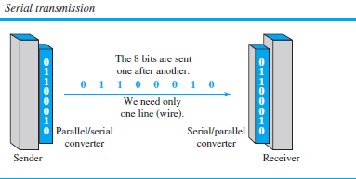
In serial transmission one bit follows another, so we need only one communication channel rather than n to transmit data between two communicating devices.
Advantage of serial over parallel transmission is that with only one communication channel, serial transmission reduces the cost of transmission over parallel by roughly a factor of n.

Slide 23
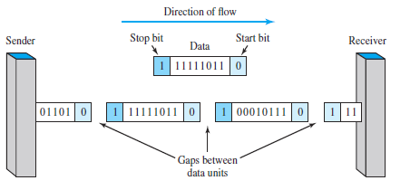
Serial transmission occurs in one of three ways: asynchronous, synchronous, and isochronous.
Asynchronous transmission is so named because the timing of a signal is unimportant.
Instead, information is received and translated by agreed upon patterns.
Patterns are based on grouping the bit stream into bytes.
Each group, usually 8 bits, is sent along the link as a unit.

Slide 24
The sending system handles each group independently, relaying it to the link whenever ready, without regard to a timer.
Without synchronization, the receiver cannot use timing to predict when the next group will arrive.
To alert the receiver to the arrival of a new group, therefore, an extra bit is added to the beginning of each byte. This bit, usually a 0, is called the start bit.
To let the receiver know that the byte is finished, 1 or more additional bits are appended to the end of the byte.
These bits, usually 1s, are called stop bits. By this method, each byte is increased in size to at least 10 bits, of which 8 bits is information and 2 bits or more are signals to the receiver.
In addition, the transmission of each byte may then be followed by a gap of varying duration. This gap can be represented either by an idle channel or by a stream of additional stop bits.

Slide 25
The start and stop bits and the gap alert the receiver to the beginning and end of each byte and allow it to synchronize with the data stream.
This mechanism is called asynchronous because, at the byte level, the sender and receiver do not have to be synchronized.
But within each byte, the receiver must still be synchronized with the incoming bit stream. That is, some synchronization is required, but only for the duration of a single byte.
The receiving device resynchronizes at the onset of each new byte.
When the receiver detects a start bit, it sets a timer and begins counting bits as they come in.
After n bits, the receiver looks for a stop bit. As soon as it detects the stop bit, it waits until it detects the next start bit.

Slide 26
That makes it an attractive choice for situations such as low-speed communication.
For example, the connection of a keyboard to a computer is a natural application for asynchronous transmission.
A user types only one character at a time, types extremely slowly in data processing terms, and leaves unpredictable gaps of time between characters.
Synchronous Serial transmission
In synchronous transmission, the bit stream is combined into longer “frames,” which may contain multiple bytes.
Each byte, however, is introduced onto the transmission link without a gap between it and the next one. It is left to the receiver to separate the bit stream into bytes for decoding purposes.

Slide 27
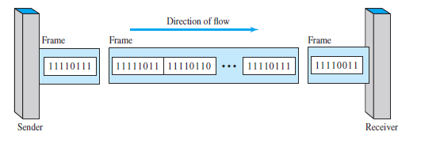
In other words, data are transmitted as an unbroken string of 1s and 0s, and the receiver separates that string into the bytes, or characters, it needs to reconstruct the information.
If the sender wishes to send data in separate bursts, the gaps between bursts must be filled with a special sequence of 0s and 1s that means idle.
The receiver counts the bits as they arrive and groups them in 8-bit units.

Slide 28
Without gaps and start and stop bits, there is no built-in mechanism to help the receiving device adjust its bit synchronization midstream.
Timing becomes very important, therefore, because the accuracy of the received information is completely dependent on the ability of the receiving device to keep an accurate count of the bits as they come in.
The advantage of synchronous transmission is speed.
Example: CPU to RAM communication
Note: Although there is no gap between characters in synchronous serial transmission, there may be uneven gaps between frames.

Slide 29
Isochronous serial transmission
In real-time audio and video, in which uneven delays between frames are not acceptable, synchronous transmission fails.
For example, TV images are broadcast at the rate of 30 images per second; they must be viewed at the same rate.
If each image is sent by using one or more frames, there should be no delays between frames.
For this type of application, synchronization between characters is not enough; the entire stream of bits must be synchronized.
The isochronous transmission guarantees that the data arrive at a fixed rate.

